Slide 1

Big Project
qa.cilsy.id
Rasyid Sholeh Rosena

Slide 2
CONTENTS
Part 01
Part 02
Part 03
Part 04
Test Scenario
Cucumber
JMeter
API

Slide 3
CONTENTS
Part 05
Part 06
Report Email
List Bugs

Slide 4
01
Test Scenario

Slide 6
02
Cucumber

Slide 7
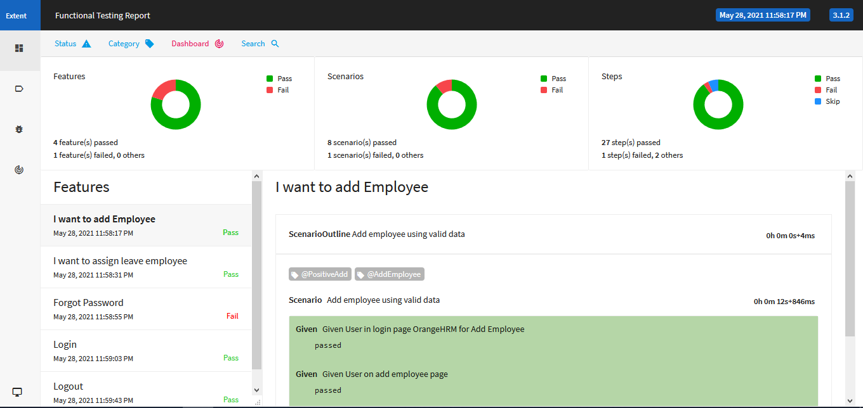

Slide 8
03
JMeter

Slide 9
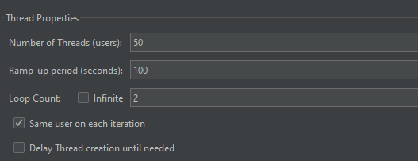
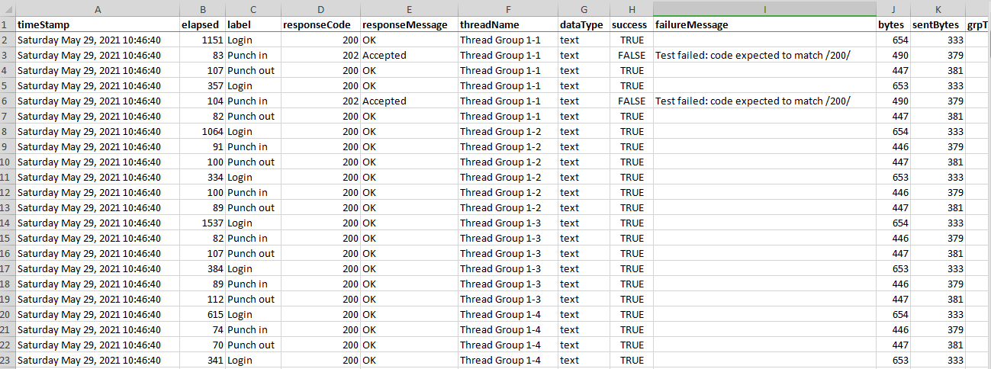

Slide 10
04
API

Slide 11
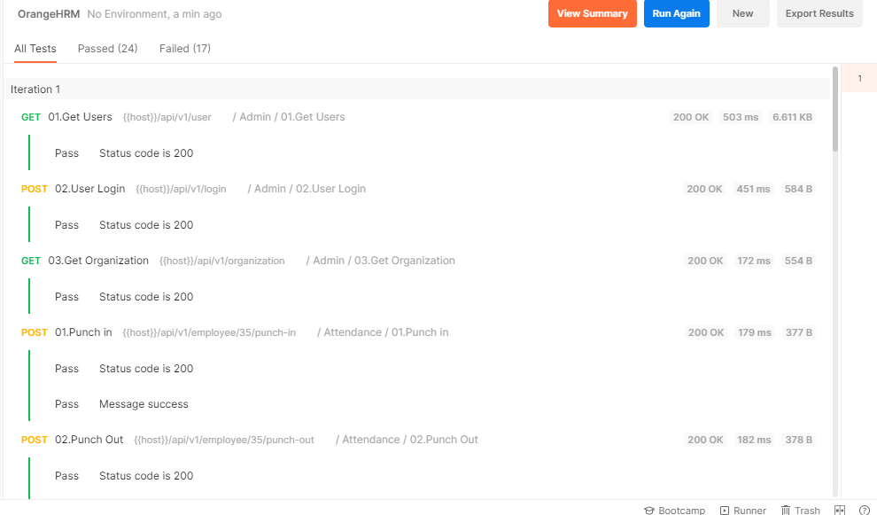

Slide 12
05
Report Email

Slide 13
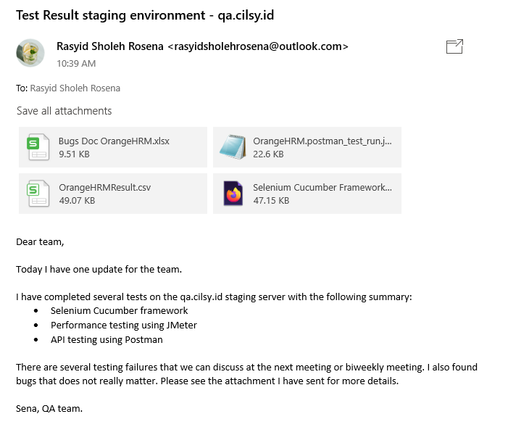

Slide 14
06
List Bugs

Slide 15
